Slide 1




INTRODUCTION TO
JAVA ENTERPRISE SOLUTIONS

Slide 2


JAVA ENTERPRISE
Java EE, J2EE and Jakarta EE refer to the same thing: a set of enterprise specifications that extend Java SE
In the first version of Java, Java enterprise extensions were simply a part of the core JDK.
Then, as part of Java 2 in 1999, these extensions were broken out of the standard binaries, and J2EE, or Java 2 Platform Enterprise Edition, was born. It would keep that name until 2006.

Slide 3

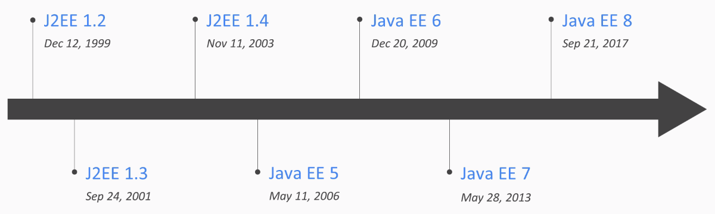
J2EE/JEE TIMELINE
For Java 5 in 2006, J2EE was renamed to Java EE or Java Platform Enterprise Edition. That name would stick all the way to September 2017, when something major happened.

Slide 4
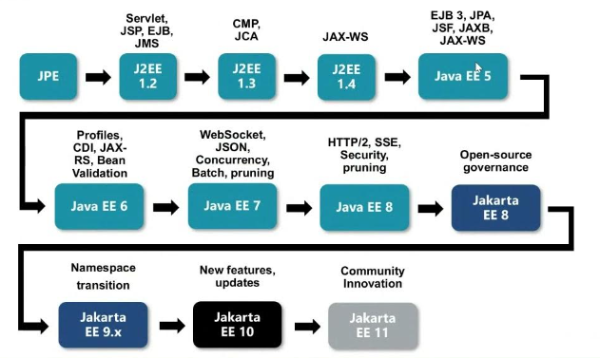
JAKARTA EE
In September 2017, Oracle decided to give away the rights for Java EE to the Eclipse Foundation (the language is still owned by Oracle).
The Eclipse Foundation legally had to rename Java EE. That’s because Oracle has the rights over the “Java” brand. So to choose the new name, the community voted and picked: Jakarta EE. In a certain way, it’s still JEE.

Slide 5
POJO VS JAVA BEAN(EJB)
POJO | Java Bean
It doesn’t have special restrictions other than those forced by Java language. | It is a special POJO which have some restrictions.
It doesn’t provide much control on members. | It provides complete control on members.
It can implement Serializable interface. | It should implement serializable interface.
Fields can be accessed by their names. | Fields are accessed only by getters and setters.
Fields can have any visibility. | Fields have only private visibility.
There may/may-not be a no-arg constructor. | It must have a no-arg constructor.
It is used when you don’t want to give restriction on your members and give user complete access of your entity | It is used when you want to provide user your entity but only some part of your entity.

Slide 6
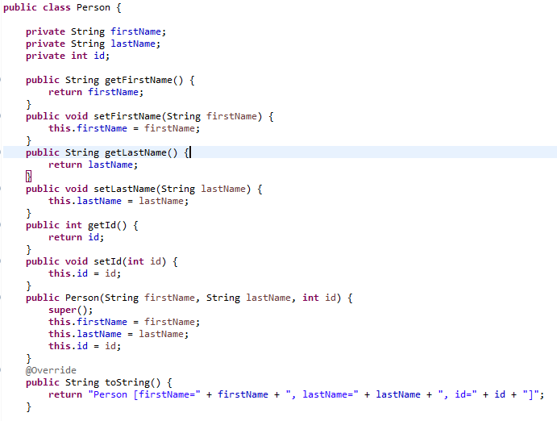
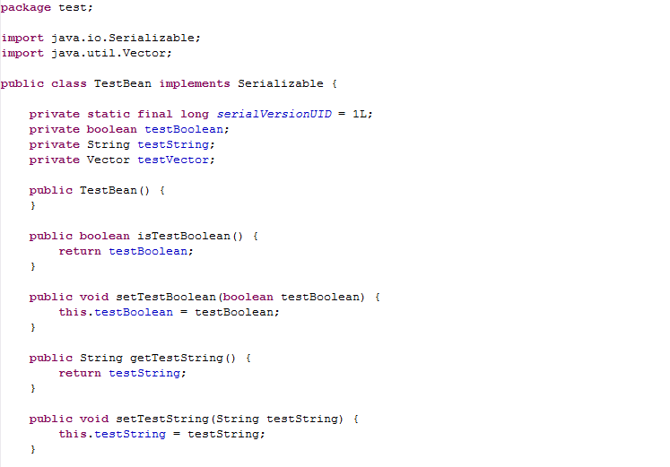
POJO VS JAVA BEAN(EJB)

Slide 7
WHAT IS WRONG WITH EJB?
Complexity: JavaBeans can sometimes lead to verbose code, especially when compared to more modern approaches for achieving similar goals.
Boilerplate Code: Historically, JavaBeans often required a lot of boilerplate code for getters, setters, and property change notification methods.
Mutability: JavaBeans typically expose mutable properties, which can lead to issues with thread safety and debugging mutable state-related bugs.
Inflexibility: JavaBeans typically follow a strict naming convention for methods (e.g., getPropertyName() and setPropertyName()), which can be limiting in terms of flexibility and readability.
Serialization Concerns: There can be challenges with serializing JavaBeans, especially if they contain complex nested objects or if the class hierarchy changes.
Maintenance Overhead: As JavaBeans rely heavily on getter and setter methods, any changes to the bean properties can lead to a lot of refactoring work throughout the codebase.
Lack of Immutability: Immutability is becoming increasingly valued in modern programming paradigms, but JavaBeans inherently promote mutability due to their design.

Slide 8
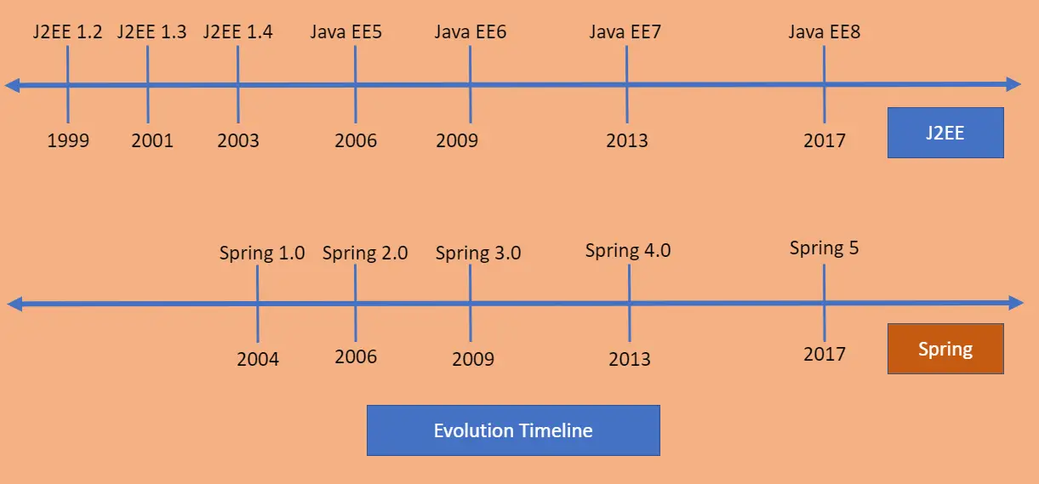
SPRING TIMELINE
HISTORY OF SPRING

Slide 9


WHAT IS SPRING?
Spring framework is an open source Java platform that provides comprehensive infrastructure support for developing robust Java applications very easily and very rapidly.
Spring framework was initially written by Rod Johnson and was first released under the Apache 2.0 license in June 2003.
Spring Framework Tutorial

Slide 10
APPLICATIONS OF SPRING
POJO Based - Spring enables developers to develop enterprise-class applications using POJOs. The benefit of using only POJOs is that you do not need an EJB container product such as an application server but you have the option of using only a robust servlet container such as Tomcat or some commercial product.
Modular - Spring is organized in a modular fashion. Even though the number of packages and classes are substantial, you have to worry only about the ones you need and ignore the rest.
Integration with existing frameworks - Spring does not reinvent the wheel, instead it truly makes use of some of the existing technologies like several ORM frameworks, logging frameworks, JEE, Quartz and JDK timers, and other view technologies.
Testablity - Testing an application written with Spring is simple because environment-dependent code is moved into this framework. Furthermore, by using JavaBeanstyle POJOs, it becomes easier to use dependency injection for injecting test data.
Web MVC - Spring's web framework is a well-designed web MVC framework, which provides a great alternative to web frameworks such as Struts or other over-engineered or less popular web frameworks.
Central Exception Handling - Spring provides a convenient API to translate technology-specific exceptions (thrown by JDBC, Hibernate, or JDO, for example) into consistent, unchecked exceptions.
Lightweight - Lightweight IoC containers tend to be lightweight, especially when compared to EJB containers, for example. This is beneficial for developing and deploying applications on computers with limited memory and CPU resources.
Transaction management - Spring provides a consistent transaction management interface that can scale down to a local transaction (using a single database, for example) and scale up to global transactions (using JTA, for example).

Slide 11
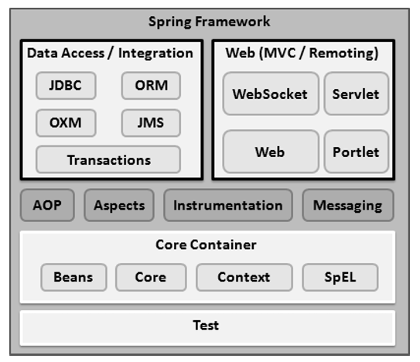
SPRING ARCHITECTURE
CORE CONTAINER
The Core module provides the fundamental parts of the framework, including the IoC and Dependency Injection features.
The Bean module provides BeanFactory, which is a sophisticated implementation of the factory pattern.
The Context module builds on the solid base provided by the Core and Beans modules and it is a medium to access any objects defined and configured. The ApplicationContext interface is the focal point of the Context module.
The SpEL module provides a powerful expression language for querying and manipulating an object graph at runtime.

Slide 12
SPRING ARCHITECTURE
DATA ACCESS
The JDBC module provides a JDBC-abstraction layer that removes the need for tedious JDBC related coding.
The ORM module provides integration layers for popular object-relational mapping APIs, including JPA, JDO, Hibernate, and iBatis.
The OXM module provides an abstraction layer that supports Object/XML mapping implementations for JAXB, Castor, XMLBeans, JiBX and XStream.
The Java Messaging Service JMS module contains features for producing and consuming messages.
The Transaction module supports programmatic and declarative transaction management for classes that implement special interfaces and for all your POJOs.

Slide 13
SPRING ARCHITECTURE
WEB
The Web module provides basic web-oriented integration features such as multipart file-upload functionality and the initialization of the IoC container using servlet listeners and a web-oriented application context.
The Web-MVC module contains Spring's Model-View-Controller (MVC) implementation for web applications.
The Web-Socket module provides support for WebSocket-based, two-way communication between the client and the server in web applications.
The Web-Portlet module provides the MVC implementation to be used in a portlet environment and mirrors the functionality of Web-Servlet module.

Slide 14
SPRING ARCHITECTURE
MISCELLANEOUS
The AOP module provides an aspect-oriented programming implementation allowing you to define method-interceptors and pointcuts to cleanly decouple code that implements functionality that should be separated.
The Aspects module provides integration with AspectJ, which is again a powerful and mature AOP framework.
The Instrumentation module provides class instrumentation support and class loader implementations to be used in certain application servers.
The Messaging module provides support for STOMP as the WebSocket sub-protocol to use in applications. It also supports an annotation programming model for routing and processing STOMP messages from WebSocket clients.
The Test module supports the testing of Spring components with JUnit or TestNG frameworks.

Slide 15
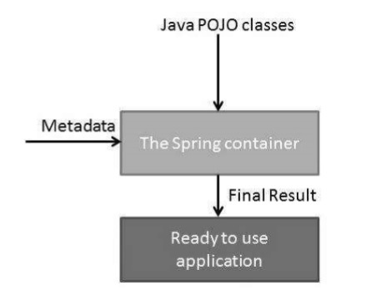
INVERSION OF CONTROL (IOC)
The Spring container is at the core of the Spring Framework. The container will create the objects, wire them together, configure them, and manage their complete life cycle from creation till destruction. The Spring container uses DI to manage the components that make up an application. These objects are called Spring Beans,
The container gets its instructions on what objects to instantiate, configure, and assemble by reading the configuration metadata provided. The configuration metadata can be represented either by XML, Java annotations, or Java code. The following diagram represents a high-level view of how Spring works. The Spring IoC container makes use of Java POJO classes and configuration metadata to produce a fully configured and executable system or application.

Slide 16
INVERSION OF CONTROL (IOC)
Spring provides the following two distinct types of containers:
Spring BeanFactory Container
Spring ApplicationContext Container
Spring ApplicationContext Container adds more enterprise-specific functionality such as the ability to resolve textual messages from a properties file and the ability to publish application events to interested event listeners. This container is defined by the org.springframework.context.ApplicationContext interface.
The ApplicationContext container includes all functionality of the BeanFactorycontainer, so it is generally recommended over BeanFactory. BeanFactory can still be used for lightweight applications like mobile devices or applet-based applications where data volume and speed is significant.

Slide 17
SPRING BEANS
The objects that form the backbone of your application and that are managed by the Spring IoC container are called beans. A bean is an object that is instantiated, assembled, and otherwise managed by a Spring IoC container. These beans are created with the configuration metadata that you supply to the container.
Bean definition contains the information called configuration metadata, which is needed for the container to know the following −
How to create a bean
Bean's lifecycle details
Bean's dependencies

Slide 18
SPRING BEANS
PROPERTIES AND DESCRIPTION
properties
This is used to inject the dependencies
autowiring mode
This is used to inject the dependencies and will be discussed in subsequent chapters.
lazy-initialization mode
A lazy-initialized bean tells the IoC container to create a bean instance when it is first requested, rather than at the startup.
initialization method
A callback to be called just after all necessary properties on the bean have been set by the container.
destruction method
A callback to be used when the container containing the bean is destroyed.

Slide 19
SPRING BEANS
PROPERTIES AND DESCRIPTION
class
This attribute is mandatory and specifies the bean class to be used to create the bean.
name
This attribute specifies the bean identifier uniquely. In XMLbased configuration metadata, you use the id and/or name attributes to specify the bean identifier(s).
scope
This attribute specifies the scope of the objects created from a particular bean definition and it will be discussed in bean scopes chapter.
constructor-arg
This is used to inject the dependencies and will be discussed in subsequent chapters.

Slide 20
SPRING BEANS
SPRING CONFIGURATION METADATA
Three important methods to provide configuration metadata to the Spring Container:
XML based configuration file.
Annotation-based configuration
Java-based configuration

Slide 21
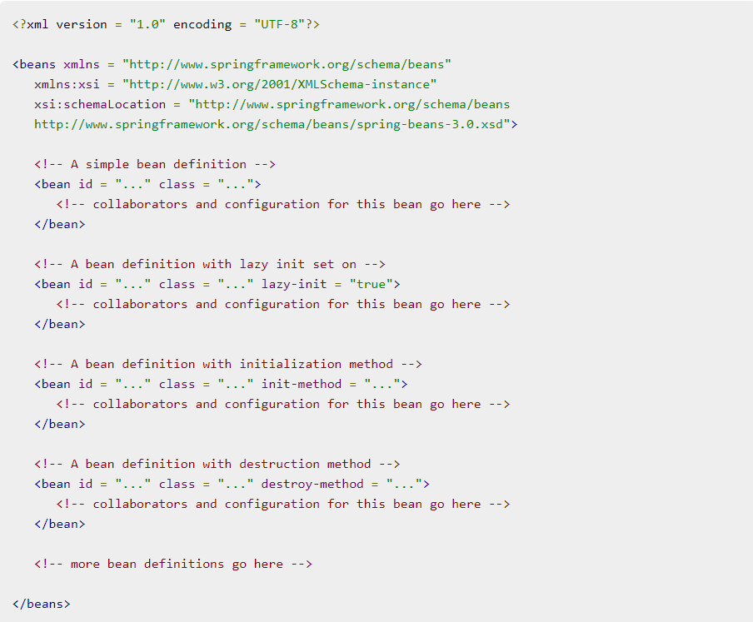
SPRING BEANS
XML BASED CONFIGURATION FILE

Slide 22
SPRING BEANS
BEAN SCOPES
singleton
This scopes the bean definition to a single instance per Spring IoC container (default).
prototype
This scopes a single bean definition to have any number of object instances.
request
This scopes a bean definition to an HTTP request. Only valid in the context of a web-aware Spring ApplicationContext.
session
This scopes a bean definition to an HTTP session. Only valid in the context of a web-aware Spring ApplicationContext.
global-session
This scopes a bean definition to a global HTTP session. Only valid in the context of a web-aware Spring ApplicationContext.

Slide 23
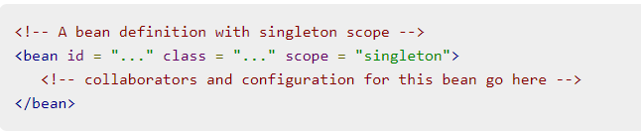
SPRING BEANS
BEAN SCOPES
If a scope is set to singleton, the Spring IoC container creates exactly one instance of the object defined by that bean definition. This single instance is stored in a cache of such singleton beans, and all subsequent requests and references for that named bean return the cached object.
The default scope is always singleton. However, when you need one and only one instance of a bean, you can set the scope property to singleton in the bean configuration file

Slide 24
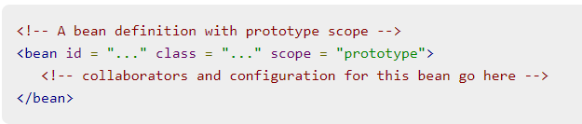
SPRING BEANS
BEAN SCOPES
If the scope is set to prototype, the Spring IoC container creates a new bean instance of the object every time a request for that specific bean is made. As a rule, use the prototype scope for all state-full beans and the singleton scope for stateless beans.
To define a prototype scope, you can set the scope property to prototype in the bean configuration file

Slide 25
SPRING BEANS
BEAN LIFE CYCLE
When a bean is instantiated, it may be required to perform some initialization to get it into a usable state. Similarly, when the bean is no longer required and is removed from the container, some cleanup may be required.
To define setup and teardown for a bean, we simply declare the <bean> with initmethod and/or destroy-method parameters. The init-method attribute specifies a method that is to be called on the bean immediately upon instantiation. Similarly, destroymethod specifies a method that is called just before a bean is removed from the container.

Slide 26
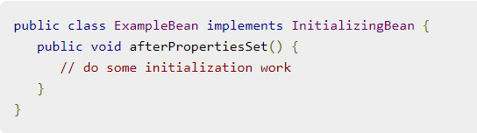
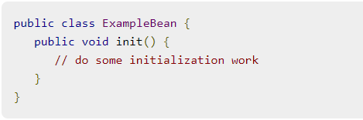
SPRING BEANS
INITIALIZATION CALLBACKS
02
01
03

Slide 27
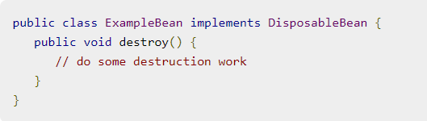
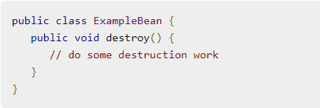
SPRING BEANS
DESTRUCTION CALLBACKS
02
01
03

Slide 28
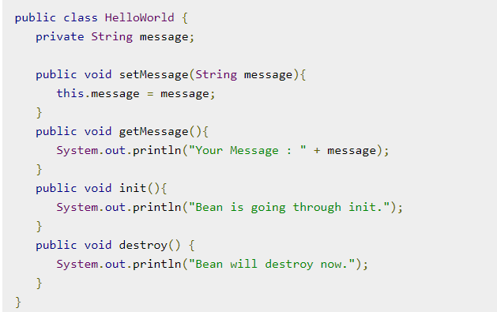
SPRING BEANS
SAMPLE APPLICATION

Slide 29
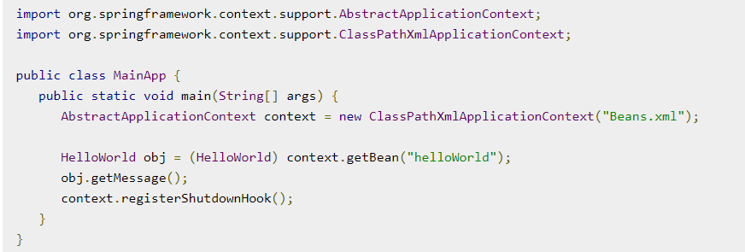
SPRING BEANS
SAMPLE APPLICATION

Slide 30
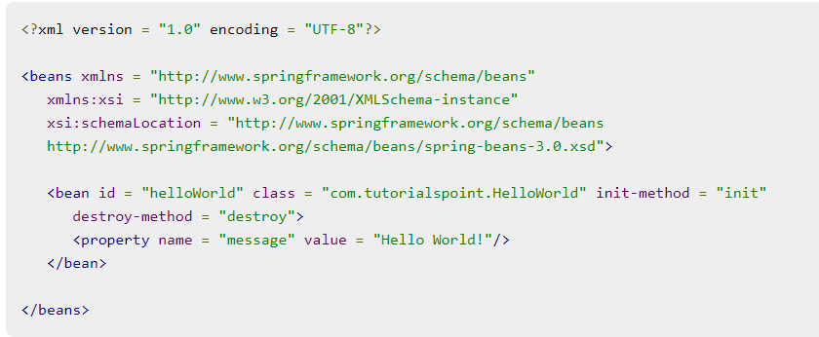
SPRING BEANS
SAMPLE APPLICATION

Slide 31
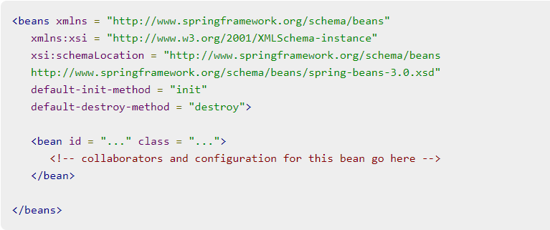
SPRING BEANS
DEFAULT INITIALIZATION AND DESTROY METHODS

Slide 32
SPRING BEANS
BEAN POST PROCESSORS
The BeanPostProcessor interface defines callback methods that you can implement to provide your own instantiation logic, dependency-resolution logic, etc. You can also implement some custom logic after the Spring container finishes instantiating, configuring, and initializing a bean by plugging in one or more BeanPostProcessor implementations.
You can configure multiple BeanPostProcessor interfaces and you can control the order in which these BeanPostProcessor interfaces execute by setting the order property provided the BeanPostProcessor implements the Ordered interface.
The BeanPostProcessors operate on bean (or object) instances, which means that the Spring IoC container instantiates a bean instance and then BeanPostProcessor interfaces do their work.
An ApplicationContext automatically detects any beans that are defined with the implementation of the BeanPostProcessor interface and registers these beans as postprocessors, to be then called appropriately by the container upon bean creation.

Slide 33
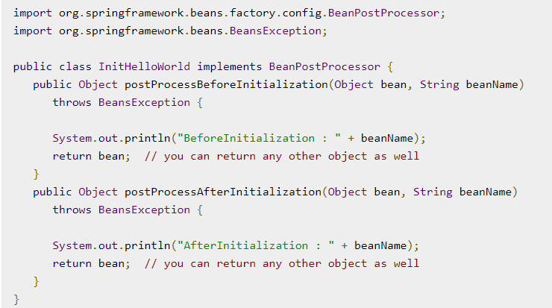
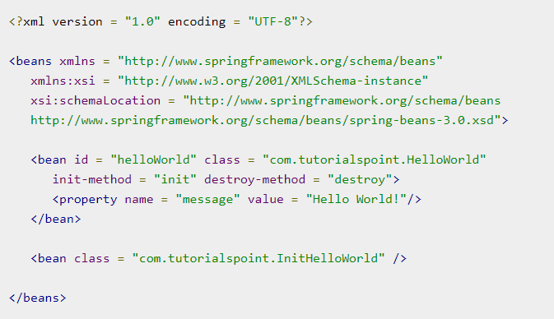
SPRING BEANS
BEAN POST PROCESSORS

Slide 34
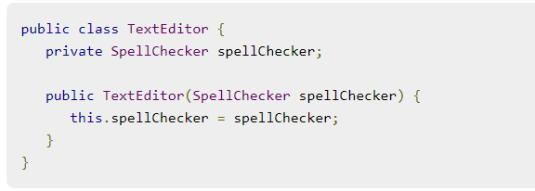
DEPENDENCY INJECTION
A dependency injection is a strategy that is used to separate the creation of dependency objects from the class that needs them.
Constructor-based dependency injection
Constructor-based DI is accomplished when the container invokes a class constructor with a number of arguments, each representing a dependency on the other class.
Setter-based dependency injection
Setter-based DI is accomplished by the container calling setter methods on your beans after invoking a no-argument constructor or no-argument static factory method to instantiate your bean.

Slide 35
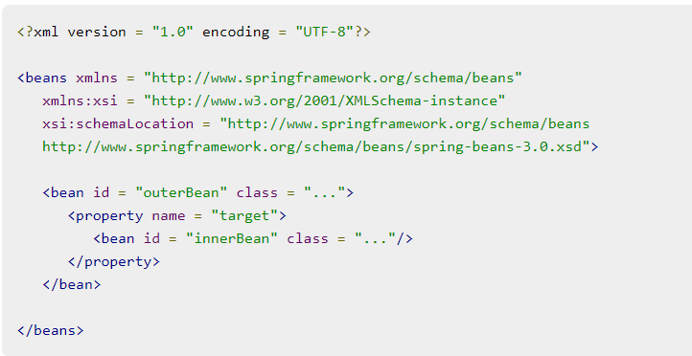
INJECTING INNER BEANS
Inner beans are beans that are defined within the scope of another bean. Thus, a <bean/> element inside the <property/> or <constructor-arg/> elements is called inner bean and it is shown below.

Slide 36
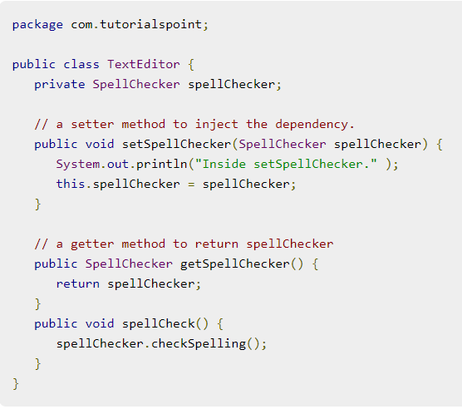
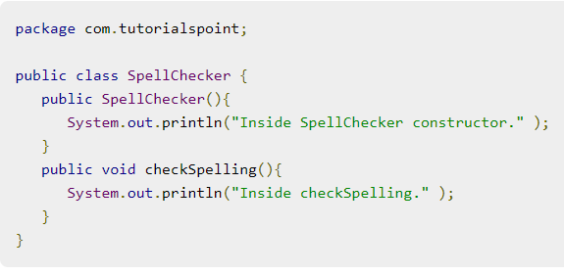
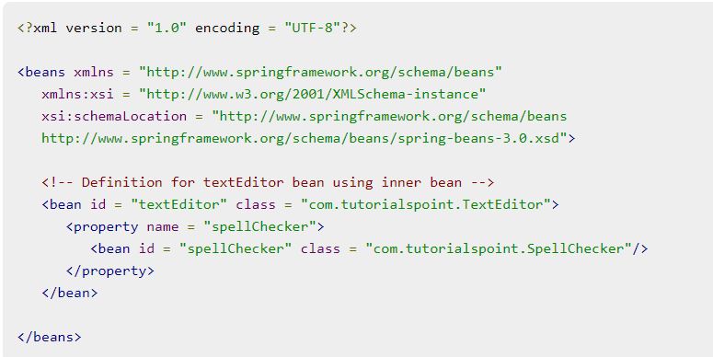

Slide 37
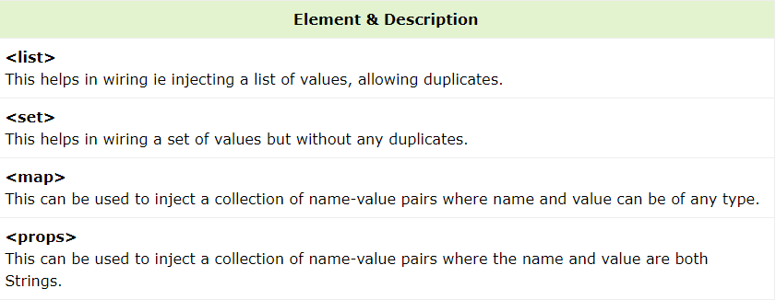
INJECTING COLLECTION
Primitive data types are configured using value attribute and object references using ref attribute of the <property> tag in your Bean configuration file.
Both the cases deal with passing singular value to a bean.
Now what if you want to pass plural values like Java Collection types such as List, Set, Map, and Properties.

Slide 38
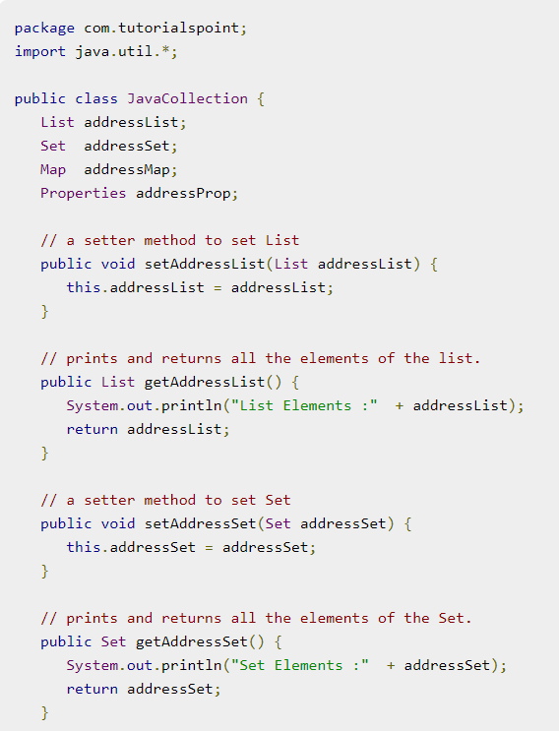
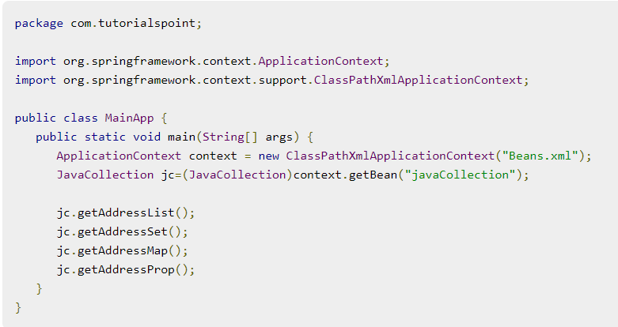
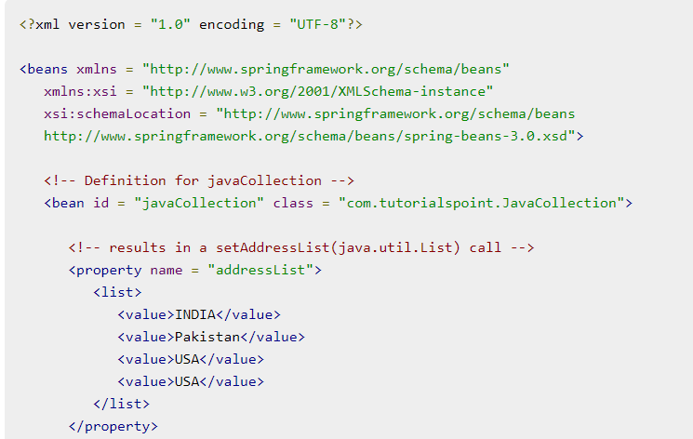

Slide 39
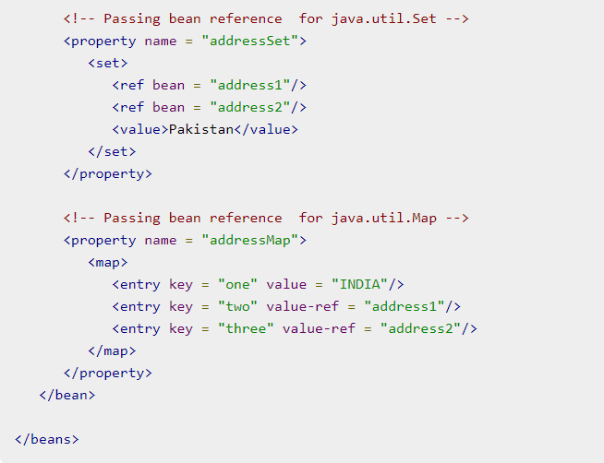
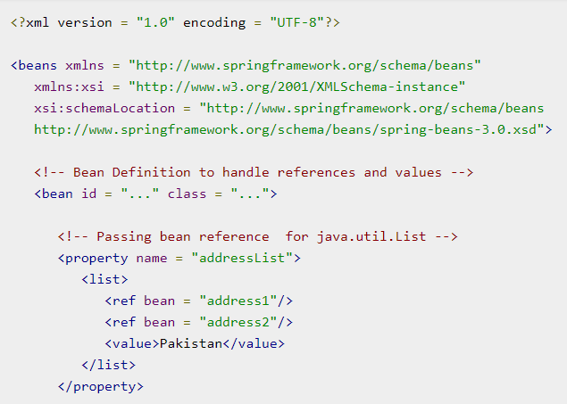
INJECTING BEAN REFS

Slide 40
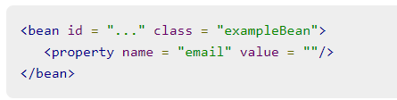
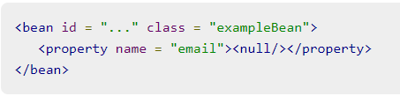
INJECTING NULL AND EMPTY STRING VALUES

Slide 41
BEANS AUTO-WIRING
You have learnt how to declare beans using the <bean> element and inject <bean> using <constructor-arg> and <property> elements in XML configuration file.
no: It’s the default autowiring mode. It means no autowiring.
byName: The byName mode injects the object dependency according to name of the bean. In such case, property name and bean name should be same. It internally calls setter method.
byType: The byType mode injects the object dependency according to type. So it can have different property name and bean name. It internally calls setter method.
constructor: The constructor mode injects the dependency by calling the constructor of the class. It calls the constructor having large number of parameters.
autodetect: In this mode, Spring first tries to autowire by constructor. If this fails, it tries to autowire by using byType.
The Spring container can autowire relationships between collaborating beans without using <constructor-arg> and <property> elements, which helps cut down on the amount of XML configuration you write for a big Spring-based application.

Slide 42
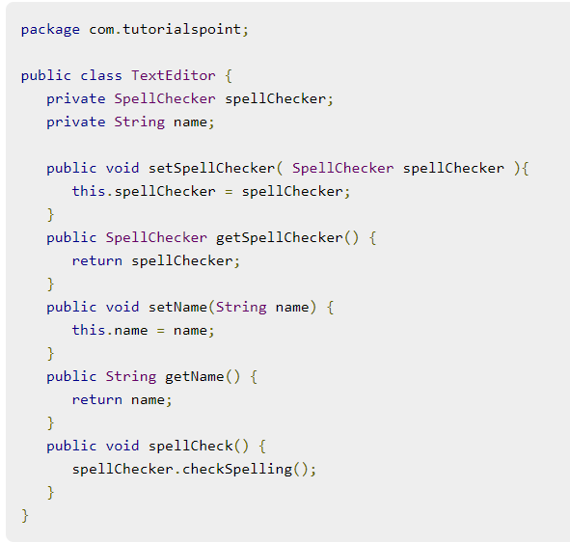
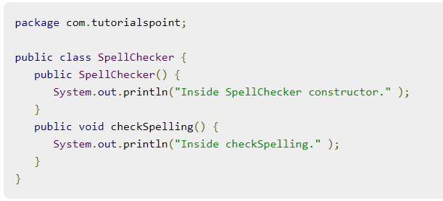
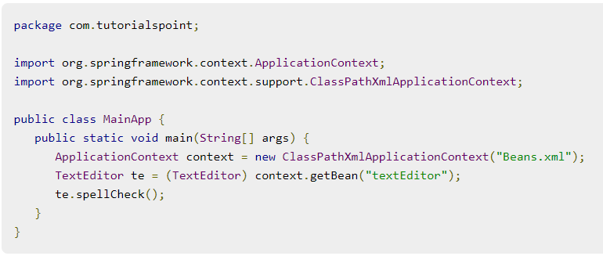
BEANS AUTO-WIRING

Slide 43
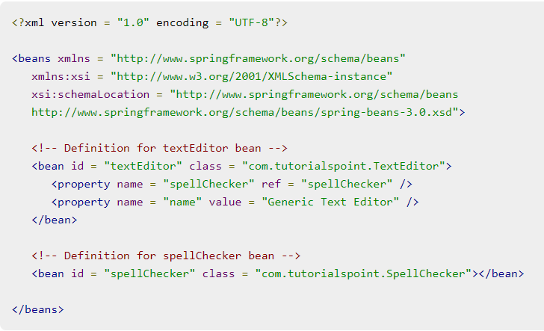
BEANS AUTO-WIRING
NO MODE

Slide 44
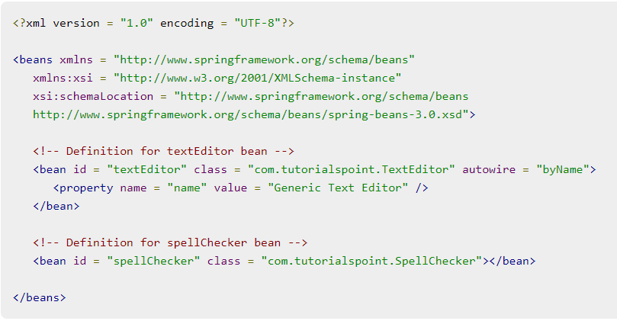
BEANS AUTO-WIRING
BY NAME

Slide 45
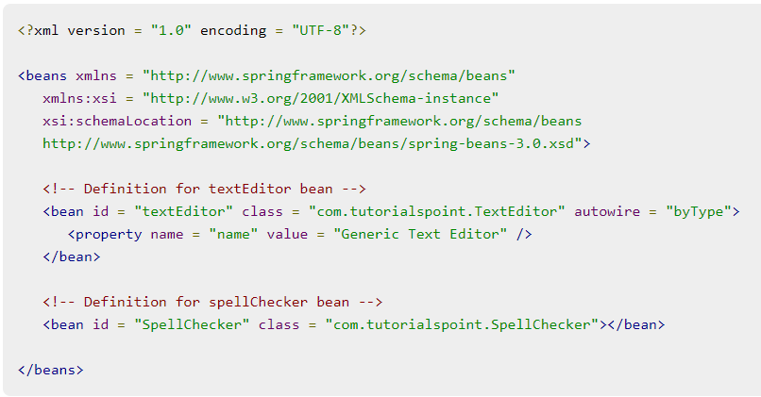
BEANS AUTO-WIRING
BY TYPE

Slide 46
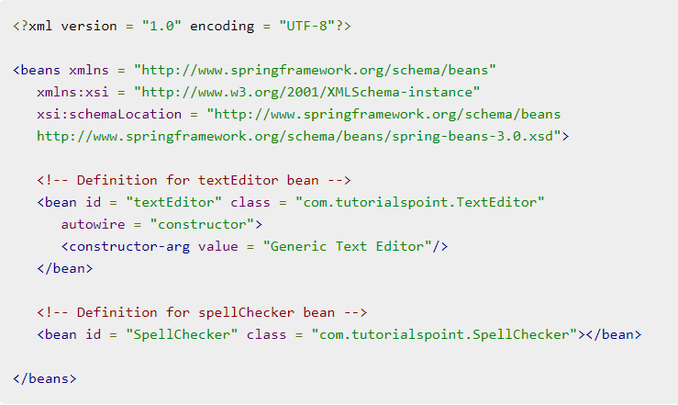
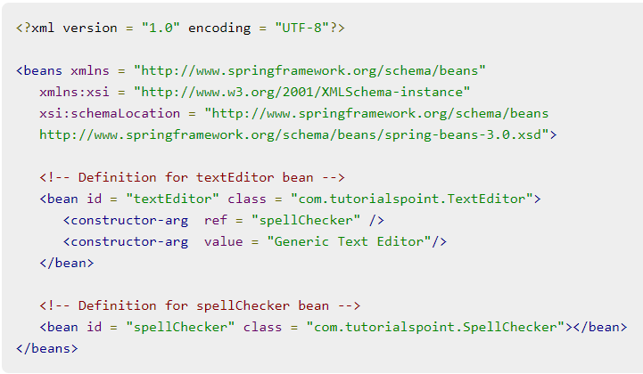
BEANS AUTO-WIRING
BY CONSTRUCTOR

Slide 47
ANNOTATION BASED CONFIG
Starting from Spring 2.5 it became possible to configure the dependency injection using annotations. So instead of using XML to describe a bean wiring, you can move the bean configuration into the component class itself by using annotations on the relevant class, method, or field declaration.
Annotation injection is performed before XML injection. Thus, the latter configuration will override the former for properties wired through both approaches.
Annotation wiring is not turned on in the Spring container by default. So, before we can use annotation-based wiring, we will need to enable it in our Spring configuration file. So consider the following configuration file in case you want to use any annotation in your Spring application.

Slide 48
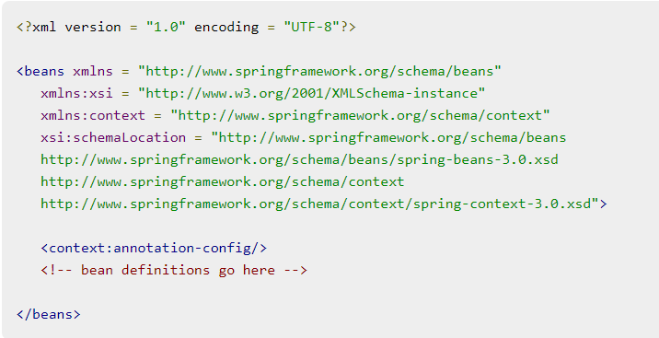
ANNOTATION BASED CONFIG
Once <context:annotation-config/> is configured, you can start annotating your code to indicate that Spring should automatically wire values into properties, methods, and constructors.

Slide 49
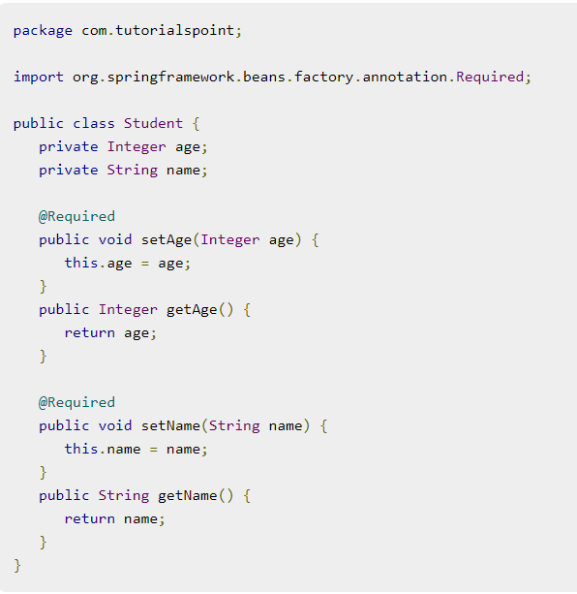
ANNOTATION BASED CONFIG
@REQUIRED
The @Required annotation applies to bean property setter methods and it indicates that the affected bean property must be populated in XML configuration file at configuration time. Otherwise, the container throws a BeanInitializationException exception. Following is an example to show the use of @Required annotation.

Slide 50
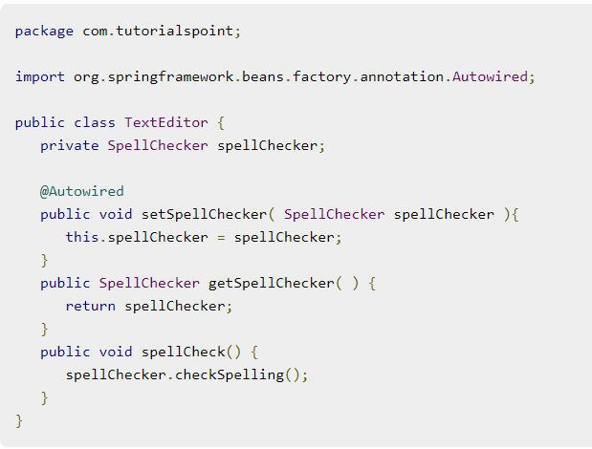
ANNOTATION BASED CONFIG
@AUTOWIRED
The @Autowired annotation provides more fine-grained control over where and how autowiring should be accomplished. The @Autowired annotation can be used to autowire bean on the setter method just like @Required annotation, constructor, a property or methods with arbitrary names and/or multiple arguments.

Slide 51
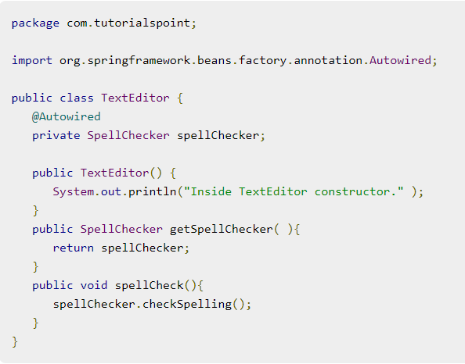
ANNOTATION BASED CONFIG
@AUTOWIRED
You can use @Autowired annotation on properties to get rid of the setter methods. When you will pass values of autowired properties using <property> Spring will automatically assign those properties with the passed values or references.

Slide 52
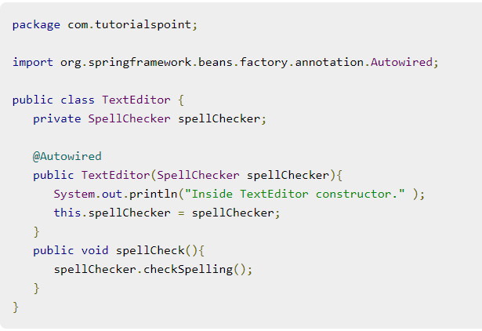
ANNOTATION BASED CONFIG
@AUTOWIRED
You can apply @Autowired to constructors as well. A constructor @Autowired annotation indicates that the constructor should be autowired when creating the bean, even if no <constructor-arg> elements are used while configuring the bean in XML file.

Slide 53
TO BE CONTINUED

